Slide 1
ZOMATO DATA ANALYSIS
Muhammad Sahanwaj

Slide 2
ANALYSIS – OPENING NEW RESTAURANT
Analyzing Countries with less competition.
States and Cities for opening new restaurant.
Rating – in the suggested country.
Total expenditure on food – in the suggested country.
Competitors.
Cuisines.
Online delivery / table booking.
Restaurants in different price range.
Dashboard.

Slide 3
Data Overview
Restaurant ID: Unique identifier for each restaurant.
Restaurant Name: The name of the restaurant.
Country Code: Country code of the location where the restaurant is situated.
City: The city where the restaurant is located.
Address: The specific address of the restaurant.
Locality: The locality or neighborhood where the restaurant is situated.
Locality Verbose: Detailed information about the locality.
Longitude: The geographical longitude coordinate of the restaurant.
Latitude: The geographical latitude coordinate of the restaurant.
Cuisines: The type of cuisine offered by the restaurant.
Currency: The currency used for transactions in the restaurant.

Slide 4
Data Overview
Has_Table_booking: Indicates whether the restaurant offers a table booking option (Yes/No).
Has_Online_delivery: Indicates whether the restaurant provides online delivery services (Yes/No).
Is_delivering_now: Indicates whether the restaurant is currently delivering orders (Yes/No).
Switch_to_order_menu: Indicates whether users can switch to the order menu (Yes/No).
Price_range: A numeric value indicating the price range category of the restaurant, providing insight into its affordability.
Votes: The number of votes or ratings/feedback received by the restaurant, indicating its popularity or customer satisfaction level.
Average_Cost_for_two: The average cost for two people dining at the restaurant, giving customers an idea of the expected expenditure.
Rating: The overall rating of the restaurant based on user reviews, serving as a measure of its quality and service.
Datekey_opening: The date when the restaurant was opened, useful for assessing its establishment period and longevity in the industry.

Slide 5
Methodology
Data Cleaning: Utilized functions like LEFT() to extract the year from the date attribute, ensuring uniformity and ease of analysis across the dataset.
Data Enrichment: Enhanced the dataset by cross-referencing country information using functions like VLOOKUP, enriching the dataset with additional variables for more comprehensive analysis and insights.
Descriptive Analysis: Leveraged Pivot Tables to analyze key metrics and identify competitor restaurants and top cuisines, providing valuable insights into market trends and competitive landscape.
Competitor Analysis: Conducted competitor analysis in suggested areas to identify competing restaurants, their offerings, and market positioning, facilitating strategic decision-making and market entry strategies.
Visualization: Created dynamic charts and interactive dashboards for data representation, enabling stakeholders to visually explore and interpret the data, facilitating informed decision-making and strategic planning.

Slide 6
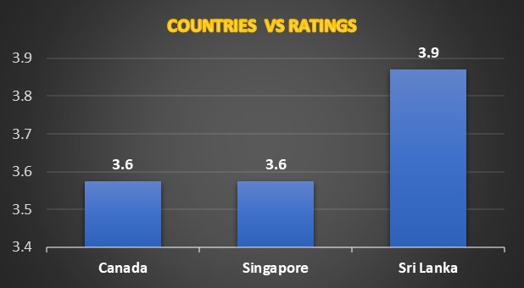
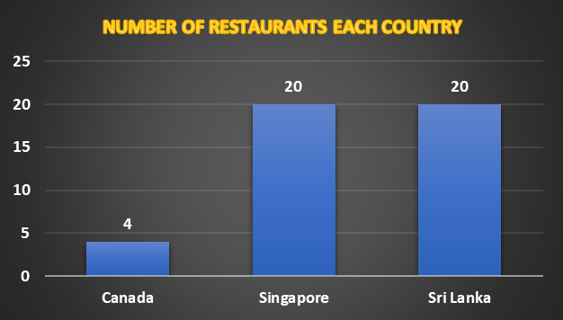
Countries suggested
Canada ,Singapore & SriLanka
The selection of countries has been conducted based on two
primary factors.
Less Competition
The ratings are average in the
countries – the rating has been
taken into consideration as this indicates the people are not satisfied with the type of restaurant that are there.

Slide 7
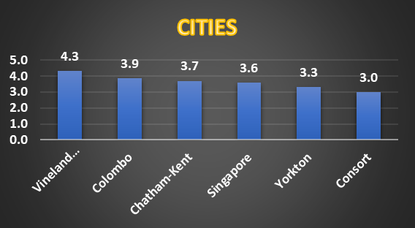
Cities suggestion
CANADA – Consort, Yorkton, Chatham-Kent
SINGAPORE - Singapore
SRI LANKA – Colombo

Slide 8

AVERAGE RATING OF RESTAURANTS IN SELECTED COUNTRIES
The ratings in the selected countries are in the range 3.6 to 3.9. The average of ratings are giving insights that people are not fully satisfied with some restaurants.
And hence its an opportunity for us to attract the people by providing the best of food and services.

Slide 9

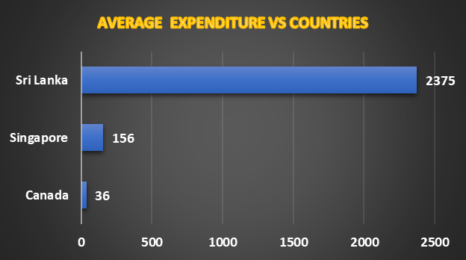
Expenditure On Food

Slide 10
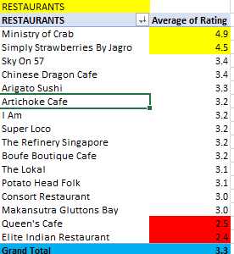
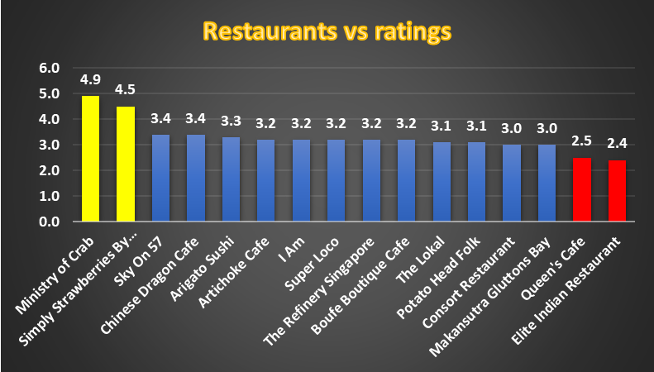
Biggest and lowest competitor

Slide 11
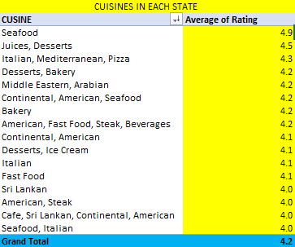
Cuisines to focused on
These are the cuisines in the suggested three countries with high number of ratings.
These are some cuisines in all the three countries. It includes local food of that country and some other cuisines.
Top preference cuisines are seafood,Juices,Desserts and Italian.

Slide 12


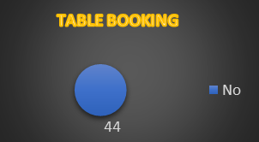
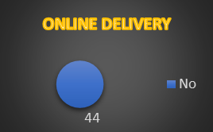
DELIVERY- ANALYSIS

Slide 13
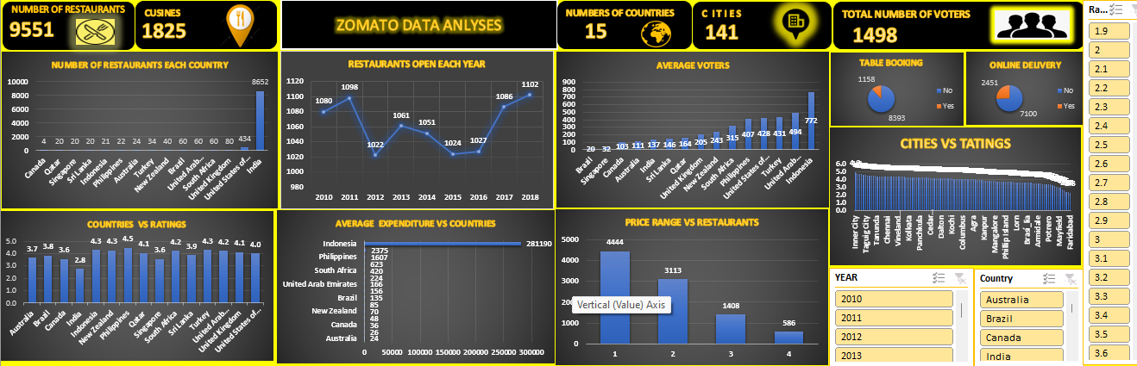
DASHBOARD

Slide 14
CONCLUSION
In conclusion, our analysis has highlighted several crucial factors for successful restaurant expansion. These include targeting countries with lower competition, maintaining cost-effectiveness, prioritizing online table booking services, and carefully selecting popular cuisines.
By strategically focusing on these aspects, we can increase our chances of success while minimizing risks associated with market saturation and customer preferences. This approach allows us to capitalize on emerging opportunities and deliver exceptional dining experiences in new markets.

